Slide 1

A Connected World leads to a Claim-less Future Elevating Customer Expectations & Experience

Slide 2

Introduction
Problem Statement
#REWRITE 4 & 5

Slide 3

THE CONNECTED WORLD

Slide 4
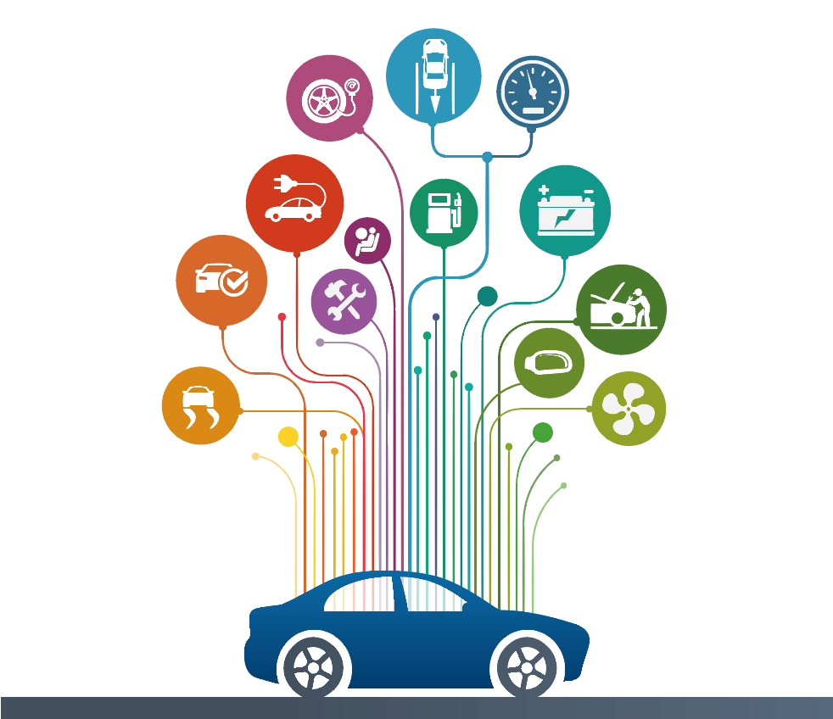
Connected CAR

Slide 5

Cars & Drivers Connected
Driving
Rest
In case of accident
Weather Conditions
Road Conditions
Vehicle is moved when engine is off
Driving Pattern Recognition
Safe/ Unsafe Geo Locations
Tampering Anti Theft Device
Vehicle Struck when parked
Gather Impact Data using pressure pads
Simple Claims notification
Damage photos
Probability of accident occurrence using AI & ML
Alert Driver
Mobile Alerts
Images
Alert 911 services
Notify Insurance

Slide 6
Value Proposition – Insurer
Improved Risk Assessment & Underwriting efficiency
Loss Control – Accurate Reimbursement valuation
Loyalty PERKS
Risk Based Pricing

Slide 7
Claim-Less Future

Slide 8

Please pay my claim and let me get on with my life………..

Slide 9





Customer Journey – Current State
Customer
Insurance Company
Benefit validation
Mange Payment
Fill Documentation
Claim Submission
Policy Administration, Claim Processing
Agent Broker
Liaison between Insurance carrier & Insured, Forms and Processing
Third-party administrator (TPA)
Notes:
Manual claim processing hassle / Wait time on roadside / Inability of the driver to reach for help
Processing time drives up other costs
Negotiations between the Insured and the Insurance company

Slide 10
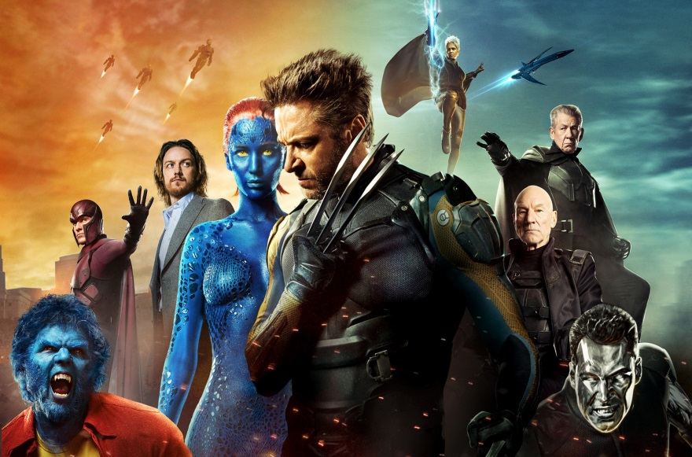
X-Men

Slide 11

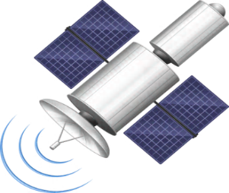





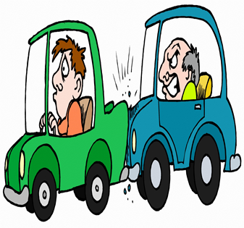

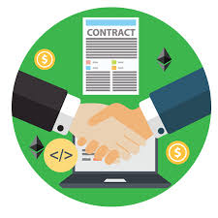
Customer Journey Map – Future State
Insurer Information system
FNOL
Claims- Smart Contracts
IOT
Claim Adjudicator
Broker
Other Insurer

Slide 12
AI – Digital Evaluation (factual and predicted claims characteristics) Speed – Faster Claim processing Customer Delight – Self Service Journey (selecting a direct repair shop)
Value Proposition

Slide 13







Girl power behind the solution
Sakina Nagamani
(Project Manager) (Developer)
Varsha Kalyani
(Developer) (Developer)
Shilpa Kritika
(Tester) (Developer)

Slide 14


